Slide 1
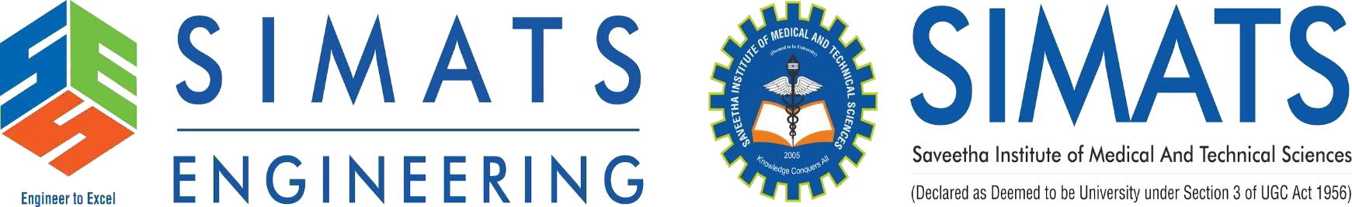
AI-Based Industrial Safety Helmet and PPE Compliance Monitoring
Name: Mothish G, Mithun Raj S, Nithish Kumar K, Porchelvan S, Divyashree S
Reg no:192421135, 192421156, 192521266, 192321181, 192421046
Course: ITA-0506 Computer Vision
Program Director : Dr. Sasi Rekha, Prof/CSE Faculty:- Mrs. R C Jeni Gracia, AP / CSE

Slide 2


Introduction
Industrial safety is one of the most important aspects of manufacturing plants, construction sites, warehouses, and factories. Every year, thousands of workplace accidents occur because workers fail to wear the required Personal Protective Equipment (PPE) such as helmets, safety vests, gloves, goggles, and face masks.
Traditional safety monitoring relies on supervisors manually observing workers, which is time-consuming, labor-intensive, and prone to human error. Continuous monitoring becomes difficult in large industrial environments.
To address this issue, this project proposes an AI-Based Intelligent Industrial Safety Monitoring and PPE Compliance System using Computer Vision and YOLO (You Only Look Once). The system automatically detects workers, identifies the required PPE, verifies safety compliance in real time, and immediately alerts supervisors if violations are detected.
This solution improves workplace safety, reduces accidents, and supports automated safety management.

Slide 3
Literature Review
Year | Author | Title | Technique Used | Contribution | Limitations
2020 | Joseph Redmon et al. | YOLOv4: Optimal Speed and Accuracy of Object Detection | YOLOv4, CNN | Improved real-time object detection with high accuracy for safety monitoring applications. | Lower performance for small or heavily occluded objects. (ScienceDirect)
2022 | Emin Guney, Husna Altin, Ayse Esra Asci et al. | YOLO-Based Personal Protective Equipment Monitoring System for Workplace Safety | YOLO-NAS, YOLOv8, YOLOv9, Deep Learning | Detects PPE such as helmets, vests, and masks in real time to improve workplace safety. | Performance depends on dataset quality and lighting conditions. (Jurnal ITSI)
2024 | Doil Kim, Shuping Xiong | Enhancing Worker Safety: Real-Time Automated Detection of Personal Protective Equipment Using Improved YOLOv8 and Edge Devices | Improved YOLOv8, Edge Computing | Enables real-time multiclass PPE detection on edge devices with enhanced accuracy. | Requires powerful edge hardware for optimal performance. (ASCE Library)
2024 | Rendra Soekarta, Muhammad Yusuf et al. | Implementation of Deep Learning for Personal Protective Equipment (PPE) Detection on Workers Using the YOLO Algorithm | YOLOv5, Deep Learning | Detects hard hats, coveralls, and other PPE for industrial worker safety. | Limited PPE categories and requires a labeled dataset. (UAD Journals)
2024 | Hao Liu, Xue Qin | Target Detection of Safety Protective Gear Using the Improved YOLOv5 | Improved YOLOv5 with ECA Attention and EIoU Loss | Improves detection accuracy for small and partially occluded PPE objects while maintaining real-time performance. | Tested mainly on railway construction environments, limiting generalization. (arXiv)

Slide 4
Problem Statement
Industries continue to face safety challenges due to the absence of continuous automated monitoring.
Current challenges include:
Manual safety inspections
Human errors during monitoring
Delayed identification of PPE violations
Lack of centralized monitoring
No real-time alerts
Increased workplace accidents
Time-consuming report preparation
Therefore, there is a need for an intelligent AI-based system that can automatically monitor workers, verify PPE compliance, generate alerts, and maintain digital safety records.

Slide 5
Objectives
The primary objectives of this project are:
Detect workers in real time using CCTV or webcam.
Identify Personal Protective Equipment (PPE).
Verify PPE compliance automatically.
Detect missing safety equipment.
Generate instant alerts for violations.
Store violation records in a PostgreSQL database.
Display live monitoring through a web dashboard.
Generate daily, weekly, and monthly safety reports.
Improve workplace safety and reduce industrial accidents.

Slide 6
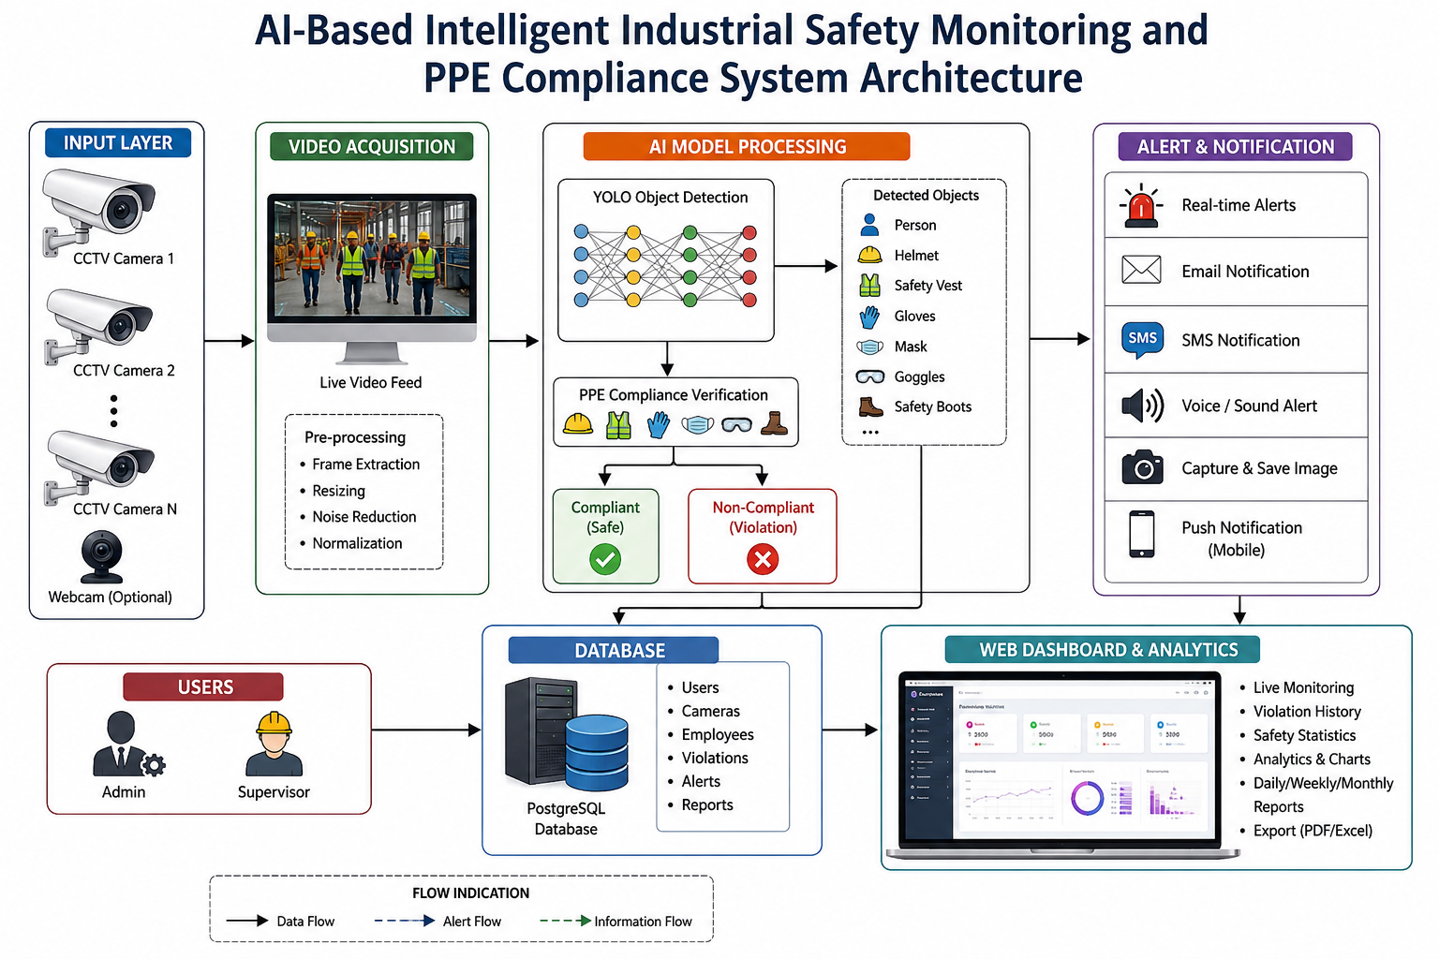
Overall System Architecture

Slide 7
Modules Introduction
Module 1: User Management & Camera Configuration
Manages user login, roles, and CCTV camera setup for the monitoring system.
Module 2: Real-Time Worker Detection & Identification
Detects workers from live video and identifies them for continuous monitoring.
Module 3: PPE Compliance Monitoring
Checks whether workers are wearing the required safety equipment using AI.
Module 4: Safety Violation Detection & Alert System
Detects safety violations and sends instant alerts to supervisors.
Module 5: Dashboard, Reports & Analytics
Displays live monitoring, violation history, and safety reports through a web dashboard.

Slide 8
THANK YOU

